Slide 1
Zoom For Teaching
4.4

Slide 2
What is ZOOM?
Zoom is an internet-based video conferencing platform
If you have a zoom account, you can schedule and run video conferencing meetings
You do not need an account to be invited to a ZOOM meeting or to join one.
The ZOOM website is zoom.us

Slide 3
Review – Basic ZOOM
What is ZOOM?
Starting meetings you were invited to
Creating an account and hosting meeting
Utilizing an app

Slide 4
Review – Advanced ZOOM
Meeting settings
Polling
Settings “Add polls to meeting”
Recording
Sharing computer sound
Making someone a host/cohost
Sharing a file in “Chat”
Annotating and Whiteboard
Remote control
Managing breakout rooms

Slide 5
This session Topics covered
Discuss 5 ways to use ZOOM for teaching:
Using ZOOM for conferencing or one-to-one support
Waitlist feature
Using ZOOM for recording and lecture capture (controls & set up)
Incorporating some students in a class via ZOOM
Technology and pedagogy
Running a ZOOM-only class
Technology and pedagogy
Professor only on ZOOM class

Slide 6
ZOOM for conferencing

Slide 7
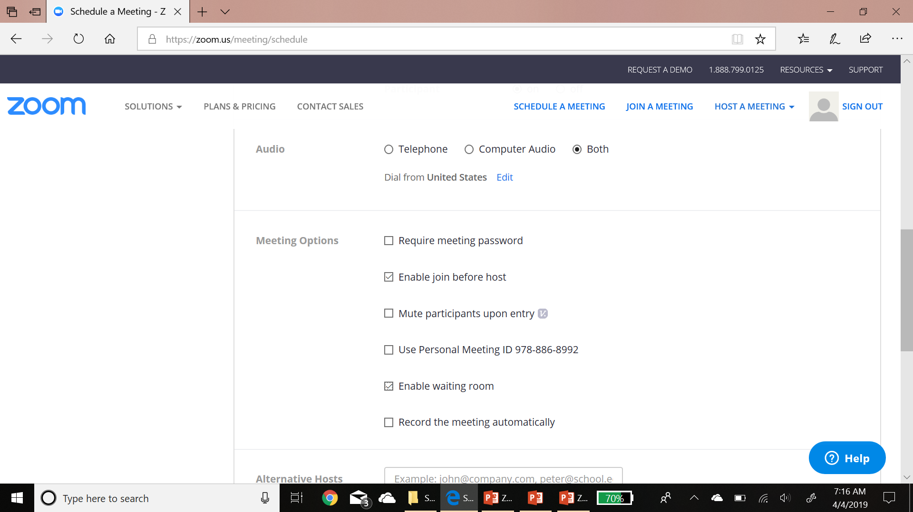
ZOOM for conferencing
One of the easiest ways to incorporate ZOOM into your teaching is for providing 1-to-1 conferences.
Schedule a new meeting.
Either tell students to go to zoom.us/join and enter your ID during their conference time.
Or schedule a new meeting (preferred) and send the invitation. **if you have multiple students, click “enable waiting room” as you set up the meeting.

Slide 8
Waiting ROOM feature
If the “Waiting room” is enabled. When students login, they will see a black screen that says “Please wait, the meeting host will let you in soon.”
You will see this button which will tells you someone is in the waiting room. You can “admit” the person or “see waiting room.”

Slide 9
Sharing Files
Another helpful advanced feature is the file sharing feature.
If you click the “chat” button, it opens up the Chat dialog on the right of the screen.
If you click the “more” button on the right, you will see the “Share file in meeting” button.
Click that, and it opens up a browser that allows you to attach files right in the chat.
All participants can then download the file to their computers.

Slide 10
Annotating a shared screen
While you or another participant is sharing a screen, all participants have the ability to annotate.
On the top bar, click “Annotate”
You will see this Tool bar pop up
You can draw, create textbooks, use the spotlight to collaborate.
At the end, you save the annotations

Slide 11
Whiteboard
Another similar feature to annotation is using the Whiteboard.
If you click “Share” and select “whiteboard”, you will get a blank white screen with annotation tools like this.
You can use it to collaborate, for sharing ideas, or for tutoring.

Slide 12
Requesting Remote Control
Another great advanced ZOOM feature is “Remote Control”. This allows you to control a presenter’s screen.
In this example, we are viewing another participants shared screen.
If we want to control that, click “View options” at the top and then click “Request Remote Control.”
Then click “request”, and a request will be sent to the person sharing his/her screen.

Slide 13
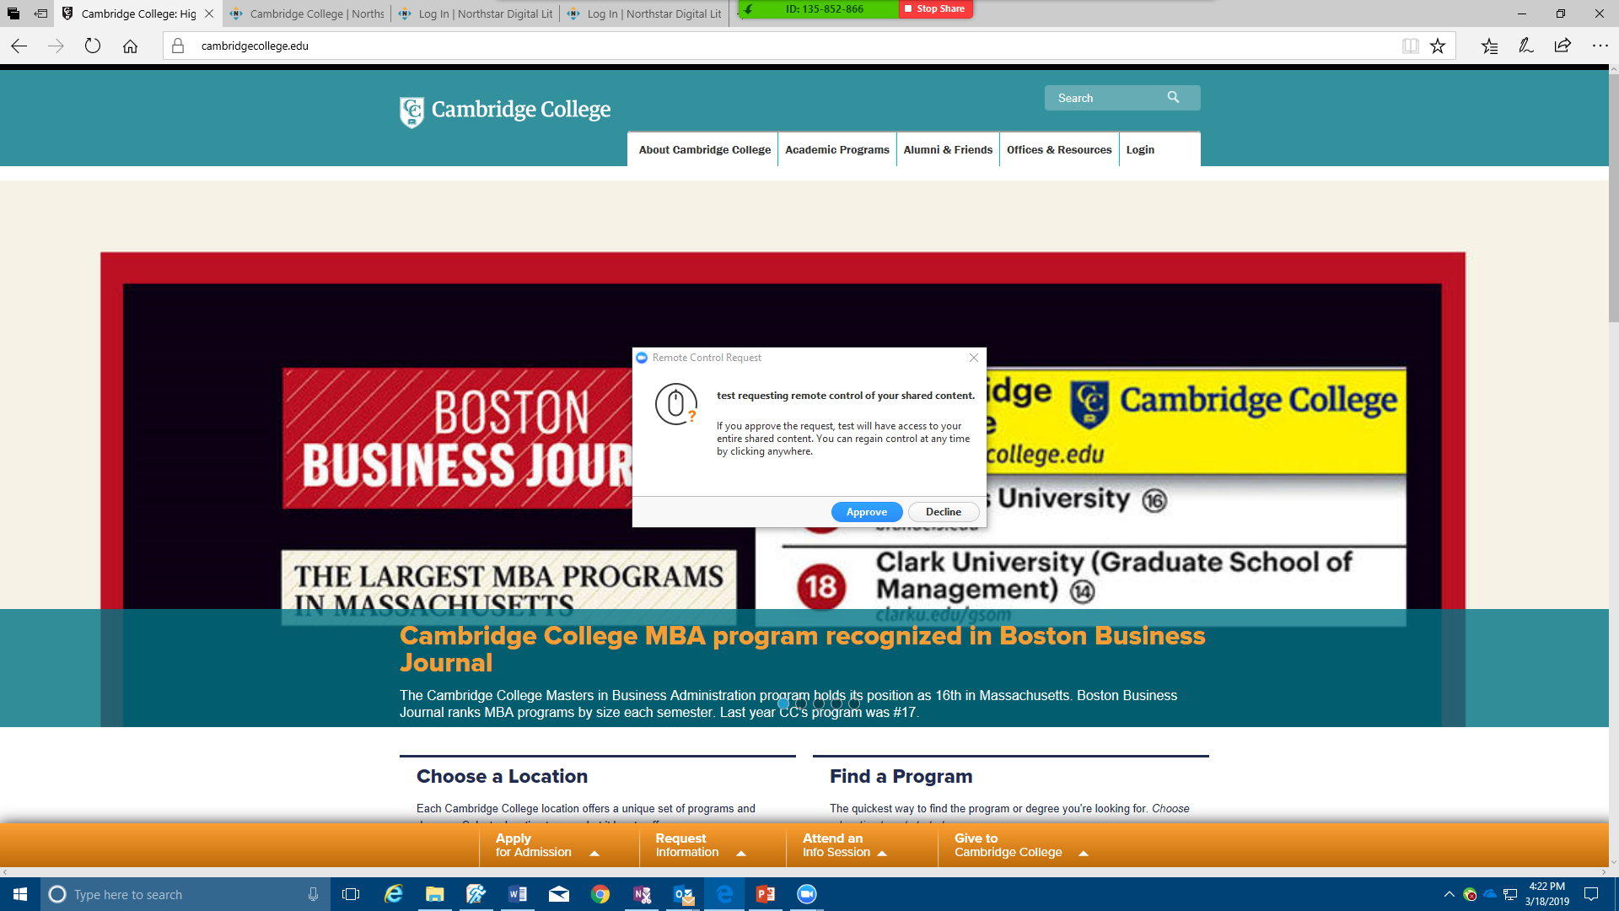
Allowing Remote control requests
If you are sharing your screen and someone sends you a request to remotely control, you will get this dialog box.
You can approve the request or decline it.
If you approve it, someone else will be able to control your screen/computer and access anything you are sharing.
If you are sharing the “screen” that person could potentially access anything on your computer.
However, this could be great for tutoring or collaborative work.
Live practice.

Slide 14
Zoom for Recording & lecture capture

Slide 15
Zoom for recording/screencasts
Because ZOOM has a built in recording feature. It can be used to record screencasts, whiteboards, or any other instructional lesson you like.
Open a session by yourself, share your screen (and camera if you wish). Then click “Record to the cloud”. Zoom will record your presentation and store it in “recordings”
The cloud based recordings can then be shared or posted to the LMS.
This is great for supplementing instruction, for online lectures or intros, for filling students in on missed material or as a reference, or for flipping the classroom.

Slide 16
Zoom for Lecture capture
Because of ZOOM’s recording ability, it can be used for lecture capture.
To do this, you need to:
Start ZOOM in a classroom
Be sure you have a microphone and a camera.
Start ZOOM, and train the camera on your lecture space.
The Boston Hood Park campus has cameras and microphones built into most classrooms. (next slides 17 & 18)
For other campuses or classroom. You will need a camera and mic (slide 19) attached to the computer.

Slide 17
Lecture capture at hood park
Many Hood Park classes are equipped with
Cameras
Microphones
To access these, start ZOOM on the classroom desktops. All the computers have the app built in.
The classrooms should automatically pick up the camera and microphone. If not, use “video options” and “sound options” in ZOOM to enable them.
If you have any issues, contact helpdesk@cambridgecollege.edu

Slide 18
Lecture capture at HoOd park
Once the camera is

Slide 19
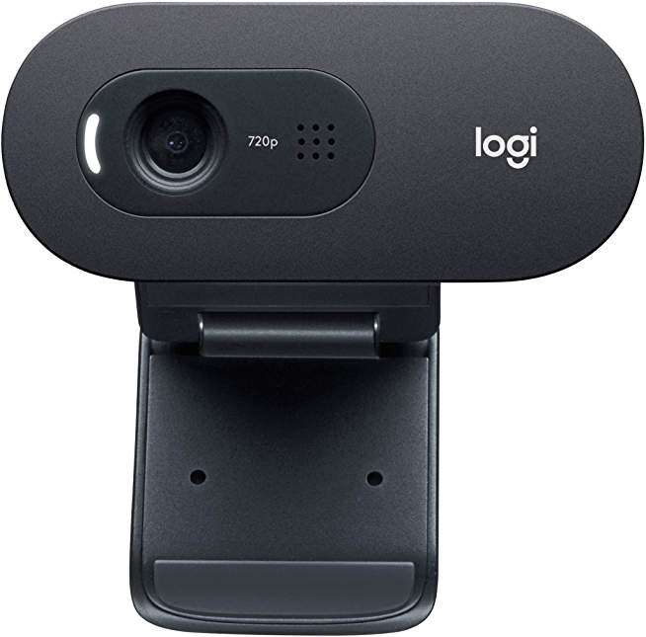
Lecture capture at other campuses
You can also use lecture capture via ZOOM at other campuses. However, you will need your own camera and microphone.
All of the regional center directors should have both cameras and microphones on hand that you can plug into the desktop or laptop USBs.
You can then train them on your lecture space, start ZOOM and record.
You might consider purchasing these. Be sure to buy an omnidirectional mic for best sound pick up like the one at the top left. Purchase an HD (ideally 1080p) camera like the one here.
You can probably get both for around $100 and submit a request for check to use your $100 faculty material stipend

Slide 20
Incorporating some students into a class via ZOOM
Advanced

Slide 21
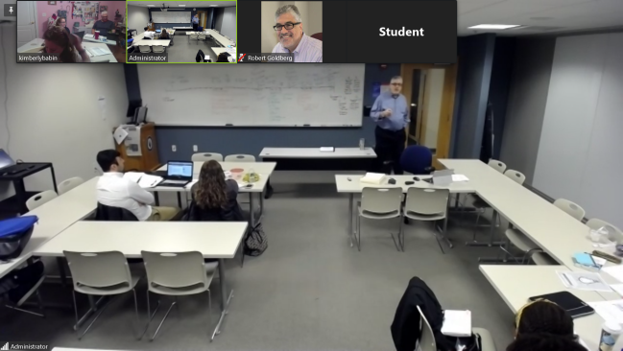
Incorporating remote students
It is possible to include a handful of students remotely into a class, but the configuration and management can be tricky.
To do this:
Email the remote students the ZOOM login with user instructions (camera on, mics muted unless talking).
Configure the mics and camera in the optimal location for remote users (Critical). In this example, an entire cart is set up in the back of the room.
However, note in the image that it is difficult to read the board.
Start ZOOM and cameras. This is an example of a decent student view

Slide 22
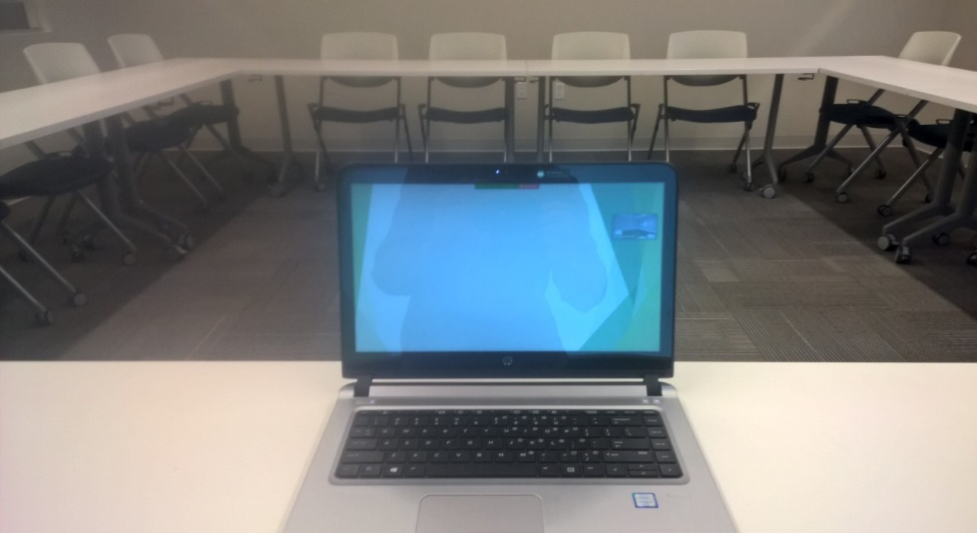
MANAGING REMOTE STUDENTS/zOOM
When incorporating remote students into a physical class, the most important things to remember are:
Place the mic and camera well
Be sure remote students know how to manage ZOOM as users
Remember to include remote students equally and not forget them.
You may also want two configurations such as on the left.
Set up a main screen configuration
Also login with a professor controlled laptop to easily see and manage students. You can pin them to your laptop.
At Hood Park, there are a few “Remote Classrooms” set up to manage remote ZOOM sessions with two screens.

Slide 23
Including Zoom students – pedagogy
In addition to mic and camera placement and being sure to include remote students, you should also be sure to:
Share any ppt or content via ZOOM Screen share
Send all handouts electronically before class, make them available on the LMS, or send them in the “Chat” feature of ZOOM.
When doing small group work, group remote students together and put them into breakout rooms so the talking doesn’t dominate the class.

Slide 24
ALL-ZOOM class

Slide 25
Breakout Rooms
The last advanced ZOOM feature that is helpful is the “Breakout rooms feature.”
If you are the host, you will be able to move participants to breakout rooms by clicking “breakout rooms.”
The box that pops up allows you to automatically or manually assign participants into the number of rooms you choose.
Then click “Create rooms” and “open all rooms”
All of the participants will receive a message to “join”. They click that to enter the rooms.

Slide 26
Managing Rooms
When participants are in the rooms, as the host, you will have the ability to see who is in each room.
You can also join any of the rooms by clicking “join”
You can also Broadcast a message to all rooms (ie 5 minutes left).
Finally, you can “close all rooms.” When you close the rooms, participants will have one minute to join the main meeting before they are automatically added back.

Slide 27
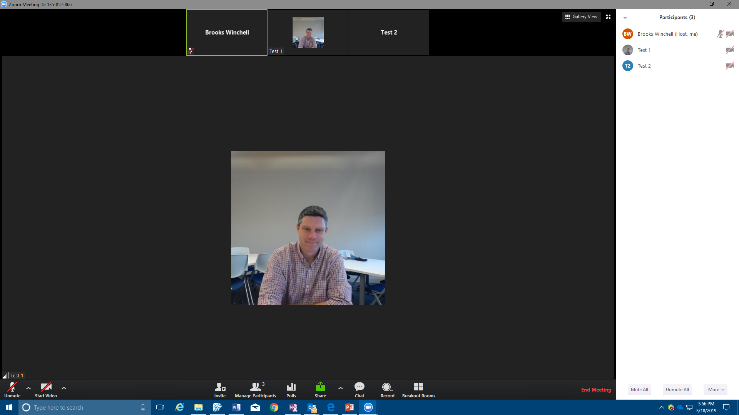
In meeting – starting a poll
All polls need to be set up before a meeting starts using the online ZOOM scheduler.
Once you start your ZOOM meeting , you will now see a poll button here.
Click that button to start the poll

Slide 28
Polling function
You will have a window displaying your poll.
Click “Launch Poll”, and it will become available for all participants on their screens.
As participants fill out the poll and click “Submit”, the results of shared back to the host’s view in a window like this.
After everyone has gone, the host can then “Share the poll results” with all participants.

Slide 29
All-Zoom class
The easiest way to deliver a course to students we have found is the all-zoom class.
In this configuration, faculty create a ZOOM meeting specifically for the class and send the link to all the students.
Students then call in to the link and the professor leads the class via video and shared content.
Professor can also initiate whole group discussions, use breakout rooms (slides 26-27)or using Polling (slides 28-29)

Slide 30
Tips for all-ZOOm class
Students need a solid grounding in how to use ZOOM and basic video conference etiquette.
Students should know how to manipulate their ZOOM views and Chat.
They should have stable internet connections, and professors should be on high-bandwidth connections.
They should be required to keep cameras on and mics muted unless talking.

Slide 31
Class in seat & professor via Zoom

Slide 32
Professor via ZOOM
The last configuration would be a class in person and a professor via ZOOM.
This can work if a professor has to travel or be away.
He or she could set up the ZOOM link and share it with a college administrator or a capable student who would then start the room projector and connect to the meeting.
There will also need to be a camera and mic set up in the classroom side.
The professor would then call in; however, he or she should have a high quality mic and camera (See set up to the left)

